Slide 1


MOJALOOP
ACCELERATOR PROGRAMME 2023

Slide 2


ABOUT PROBASE
ProBASE Limited is a leading Fintech and ICT company with a strong track record of providing payment and collection solutions to key sectors of the economy both to public and private sector.
Our core competencies lie in our ability to deliver innovative payment solutions, aggregation services, and bespoke solutions for any type of client to address any type of requirements or needs.
Our products and services are used in process automation, reporting, collections, transaction processing & settlements.

Slide 3






OUR CORE
SOLUTION ADDRESS
$
PAYMENTS & COLLECTIONS
DIGITIZATION / PROCESS AUTOMATION
TRANSACTION PROCESSING, ANALYTICS & RECONS
AGGREGATION SERVICES
/ BESPOKE SOFTWARE DEVELOPMENT

Slide 4















OUR PRODUCTS
$
Pensions/ Insurance Contribution (Banked & unbanked)
Cooperatives Development Management & Disbursement/ CDF
Road Tolling
School Management System/ e-Learning
Payments/ Integration/Aggregation
MIS/Analytics tools for decision making
e-TAX
Domestic & Customs
Branchless Banking
Mobile & E-Wallet/ USSD
FISP
Funds Transfer & Cheque Imaging clearing System
Financial Inclusion/ Switching

Slide 5









COUNTRIES WORKED/ OPERATED IN
Serving Sub-Saharan Africa with a wide array of innovative technological services. With deep market knowledge and a focus on customer satisfaction.

Slide 6
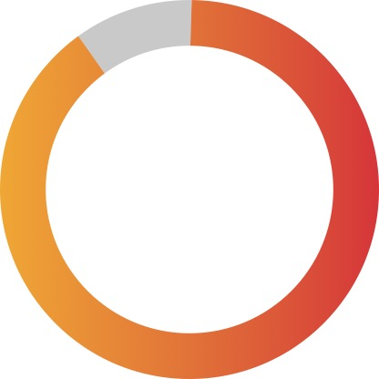
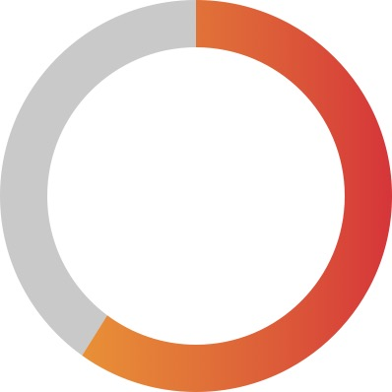
FUN FACTS
100%
100%
100%
90%
60%
NAPSA
National Pension
Collections
NHIMA
National Health Insurance Collections
NRFA
Toll Collections
ZRA
National Tax Collections
Through SmartPay
FISP
National Farmer Input Disbursements

Slide 7

































OUR VALUED CLIENTS AND PARTNERS
Engineering Institution of Zambia

Slide 8























Slide 9
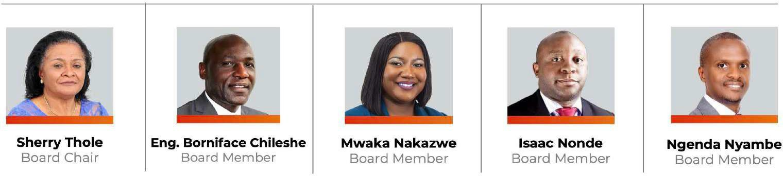

OUR BOARD MEMBERS

Slide 10

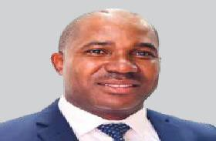


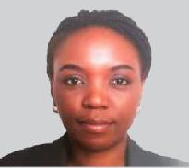




Roy Muyelu
CEO
Lead the development of the company’s short and long- term strategy
implementing the company vision and mission
Maintain expansion opportunities & industry developments
Chola Bwalya
COO
Oversees the company’s business operations
Ensures the company has effective operational and financial procedures in place
Oversees the business commercial division
Mwase Simwase
CIO
Designing & customizing tech systems & platforms
Help Clients maximize applications/systems ROI.
Manage development team personnel
Technological staff recruitment & Retention
Dr. Diana Kangwa
CTO
Tech Support
R&D
Standards
Machine Learning & Artificial Intelligence
Security
OUR EXECUTIVES
Andrea Nyirenda
CxO
Design & delivery of the company’s products & services
User Experience Brand & Consumer Engagement
Moses B. Mwale
CFO
Financial forecasting
Budgets
Financial reporting
Lars Fuglerud
FinTech Service Delivery
Service delivery management
Customer support alignment
Analyze customer requirements
Compliance securement
Zanyiwe Nthatisi
South Africa
Regional policy and regulation specialist
Plan and manage operations and strategy in the SADC region
Oversee quality control, stakeholder and performance management

Slide 11







THE PROJECT TEAM
Chiza Mhlanga
Probase Limited
Acting CIO
Samuel Mwale
Probase Limited
Head PMO
Lynn Temwani Zimba
Probase Limited
CRM
Luis Roy Zulu
Probase Limited
Tech Lead
Kakuhu Kabwe
Probase Limited Software Developer
Kachinga Shezongo
Probase Limited
PMO
Telvin Mwanza
Probase Limited Business Analyst

Slide 12
KEY HIGHLIGHTS
1. Impactful Alliances:
Partnerships and collaborations within Mojaloop facilitate noteworthy payment solutions.
These alliances play a pivotal role in driving financial inclusion initiatives.
2. Valuable Knowledge and Insights:
The team gained valuable knowledge and insights from involvement with Mojaloop.
Recognized the potential for impactful partnerships and collaborations within the Mojaloop ecosystem.
3. Comprehensive Understanding of Payment Systems:
Mojaloop and DFSP courses provided a structured and well-planned educational approach.
Participants gained a comprehensive understanding of payment systems.
4. Expertise and Innovation:
The educational approach equipped participants with expertise in payment technologies.
Participants are now capable of navigating and innovating within the realm of payment technologies.

Slide 13
MOJALOOP WORKSTREAM
2. Focus on Merchants and Payments Workstream:
We have specifically chosen to focus on the Merchants and Payments workstream, recognizing the critical role that merchants play in the economic ecosystem.
The team's goal in selecting the Merchants and Payments workstream is to ensure the digital transformation of the payment process.
The aim is to enhance convenience for consumers in the payment experience.
1. Goal of Accelerator Program Participation:
The primary goal of participating in the accelerator program is to familiarize the team with ongoing initiatives.
Identifying opportunities to contribute to digital payments, financial inclusion, and interoperability is a key objective.

Slide 14

THE SOLUTION

Slide 15
SOLUTION EXPECTATIONS
O1
We will develop a cutting-edge and frictionless payment gateway platform. This platform will serve as a bridge between online or physical merchants and various payment methods, enabling secure and efficient transactions.
What sets this system apart is its advanced fraud detection and prevention algorithms, providing an extra layer of security for both merchants and customers.
Additionally, it offers real-time analytics and reporting functionality, allowing merchants to gain valuable insights into their transaction data for informed decision-making.
This system's unique selling point lies in its seamless integration functionality with a wide array of payment methods, ensuring a frictionless payment experience for customers regardless of their preferred payment option.
02
03
04

Slide 16

Thank You

